Slide 1
CHAPTER 9
Introduction to
IP Routing

Slide 2
OBJECTIVES
Explain the purpose and properties of routing

Slide 3
ROUTING BASICS
In IT, routing essentially refers to the process of taking a packet from one device and sending it through the network to another device on a different network.
To be capable of routing packets, a router must know at least the following information:
  Destination address
  Neighbor routers from which it can learn about remote networks
  Possible routes to all remote networks
  The best route to each remote network
  How to maintain and verify routing information

Slide 4
ROUTING BASICS (CONTD…)
  If a network isn’t directly connected to the router, the router must use one of two ways to learn how to get to it. One way is called static routing, which can be a ton of work because it requires someone to hand-type all network locations into the routing table.
  The other way is known as dynamic routing. In dynamic routing, a protocol on one router communicates with the same protocol running on neighbor routers. The routers then update each other about all the networks they know about and place this information into the routing table. If a change occurs in the network, the dynamic routing protocols automatically inform all routers about the event.

Slide 5
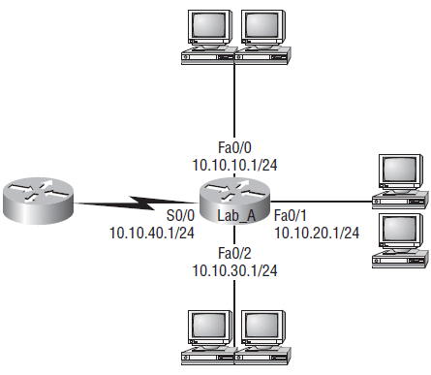
ROUTING BASICS (CONTD…)
A simple routing example

Slide 6
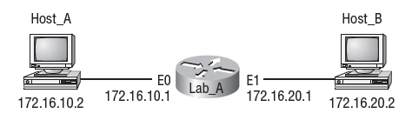
THE IP ROUTING PROCESS
IP routing example using two hosts and one router

Slide 7
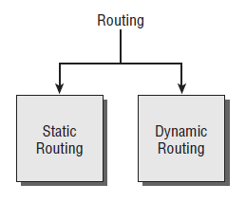
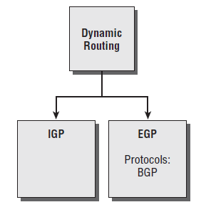
STATIC AND DYNAMIC ROUTING
  Routing options
  Dynamic routing options

Slide 8
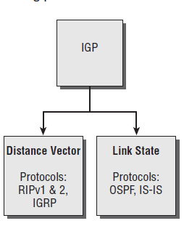
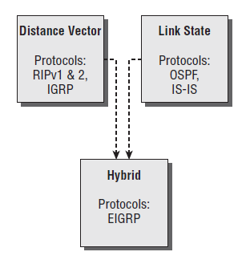
STATIC AND DYNAMIC ROUTING (CONTD…)
  DV and LS routing protocols
  Hybrid routing

